Slide 1
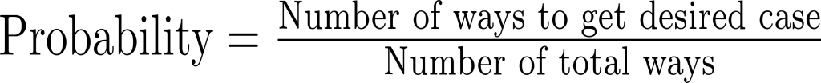

Probabilities with cards
Discrete uniform law
Example: Probability of drawing an ace

Slide 2
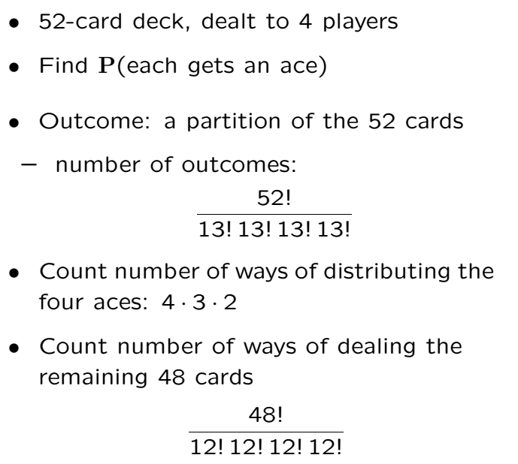
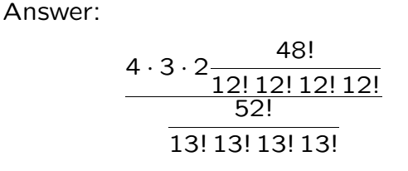
Splitting Deck into 4; one Ace Each
= 10.5%

Slide 4
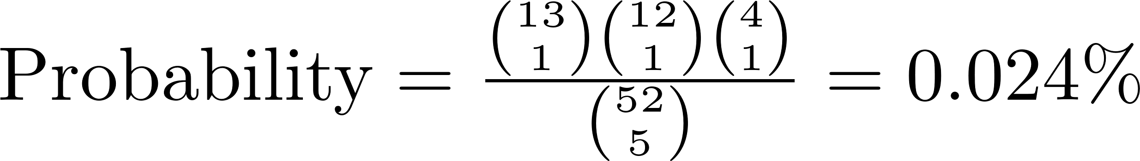
Four of a kind
A hand in poker
Four cards of same rank and something

Slide 5
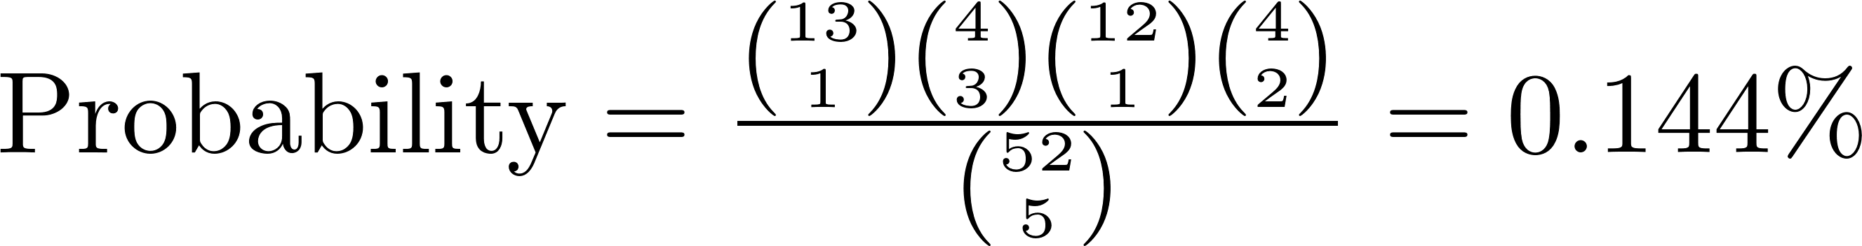
Full House
Three cards of same rank + two other cards of same rank

Slide 6
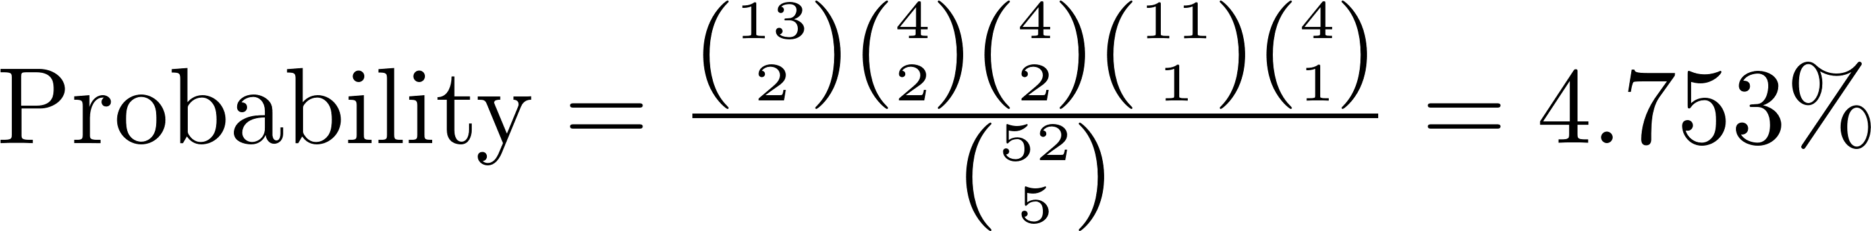
Two Pair
Pair of cards of same rank + other pair of cards of same rank + something

Slide 7
Acknowledgements and Citations
Parts of these slides are adapted from the following resources:
Power Point Lecture Slides for the Textbook http://bcs.wiley.com/hebcs/Books?action=index&bcsId=8676&itemId=1118324560
John Tsitsiklis. 6.041 Probabilistic Systems Analysis and Applied Probability, Fall 2010. (Massachusetts Institute of Technology: MIT OpenCourseWare),http://ocw.mit.edu (Accessed 13 Apr, 2015). License: Creative Commons BY-NC-SA

